Slide 1

Data Analytics Portfolio
Ava Kramer

Slide 2

Ava Kramer ava.m.kramer@gmail.com LinkedIn Github
I am an early childhood education teacher who is currently making a career change to data analytics.
With a background in psychology, I am always wanting to know the “why?”. I love exploring until I can find the solution to problems.
My mom works in computer science, and that is what inspired me to pursue my own career change! Outside of work I love spending time outdoors, watching movies, reading, and spending time with my family and new puppy.

Slide 3

Projects Overview
Video Game Popularity Project
Preparing for Influenza Season in the U.S.
Rockbuster Stealth Data Analysis Project
Instacart Grocery Basket Analysis Project
Anti-Money Laundering at Global Bank
World Happiness Report Analysis

Slide 4
Video Game Popularity Project
Project Goals
Data Sets
Tools Used
Skills Used
To understand the current popularity of certain games/genres in order to predict how GameCo’s new games may do once they hit the market.
http://www.vgchartz.com/
Microsoft Word
Microsoft Excel
Microsoft Powerpoint
Excel
Data Cleaning
Grouping Data
Summarizing Data
Descriptive Analysis
Visualizing Results
Presenting Results

Slide 5
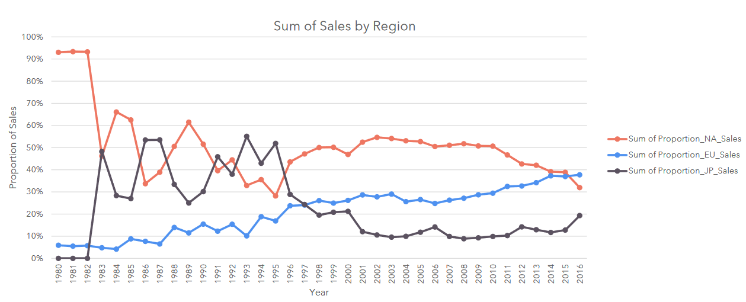
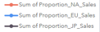
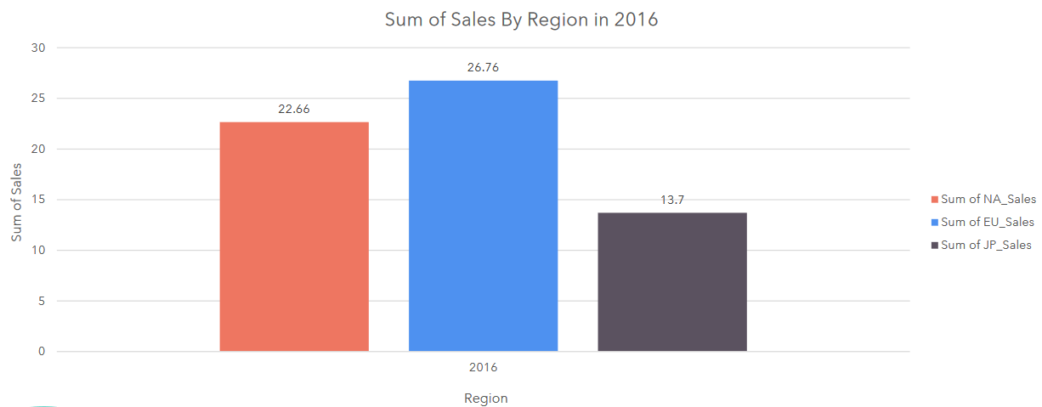
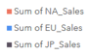
Sales by Region
Europe’s sales have been consistently climbing over time, and it 2016 they had the highest sales when compared to North America and Japan.
In 2016 North America had the second highest sales and Japan had the third highest sales. However, it is important to note the top chart.
While NA may have had higher sales than JP in 2016, there sales have been declining while JP’s sales have been climbing.

Slide 6
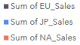
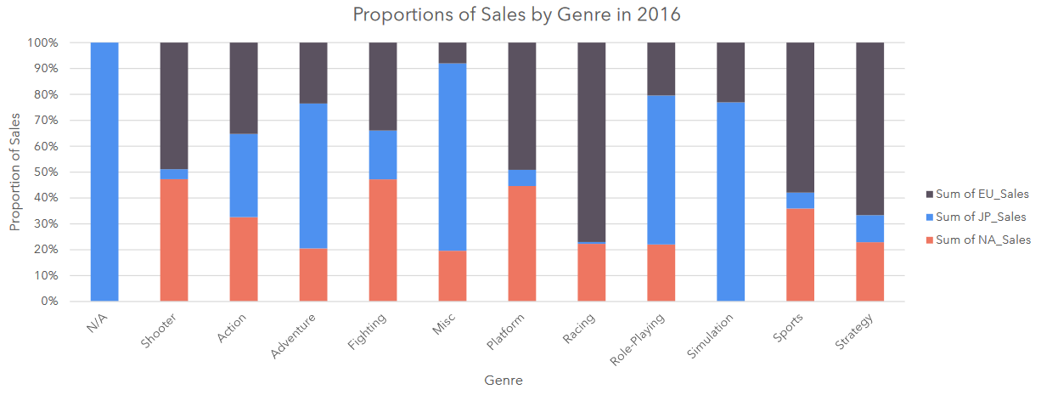
Sales by Genre
Top 3 genres in North America:
Shooter
Fighting
Platform
Top 3 genres in Europe:
Racing
Strategy
Sports
Top 3 genres in Japan:
N/A
Miscellaneous
Simulation

Slide 7
Analysis Process
For the Video Game Popularity Project, I used Microsoft Excel to compare key components such as sales, genre, and region to find patterns and relationships between variables.
This was done by cleaning the data to make it consistent and organized. I was then able to create tables and charts to illustrate relationships in a clear manner. After conducting analysis through Excel, I was able to come to my conclusions and give recommendations based on what I found. These conclusions and recommendations were made into a PowerPoint presentation to clearly explain how and why these conclusions were made.

Slide 8
Conclusions & Recommendations
Moving forward, I would recommend putting a majority of the marketing budget into Europe. Sales have been steadily climbing and in 2016 they had the highest sales out of the three regions. The games that should be promoted are those in the racing, strategy, and sport genres, as they are the most popular.
While North America had the highest number of sales in 2016, they have been declining since 2010. I would dig deeper and to try and find the cause of the decline to see if it can be combatted. The games that should be promoted are those in the shooter, fighting, and platform genres.
Japan had the lowest sales in 2016. However, by looking at the line chart we see that sales have started to rise. Two of their most popular genres are N/A (unknown) and miscellaneous. Since we don’t know what games are in these categories, I would do more digging to see if more information could be found. The other popular genre was simulation games and this one should be marketed to the region.

Slide 9
Project Brief: GameCo Project Brief
Project Report: GameCo Final Report
Project Final Presentation: GameCo Presentation
Project Links

Slide 10
Preparing for Influenza Season in the U.S.
Project Goals
Data Sets
Tools Used
Skills Used
To help a medical staffing agency plan for influenza season by determining where they should send the most staff.
CDC
US Census Bureau
CDC (Fluview)
CDC (Survey)
Microsoft Word
Microsoft Excel
Microsoft Powerpoint
Tableau
Excel
Data Cleaning
Data Integration
Data Transformation
Hypothesis Testing
Visual Analysis
Forecasting
Storytelling in Tableau
Presenting Results

Slide 11
Influenza Project Overview
Goal: Properly allocate staff and resources to different regions of the U.S. during influenza season.
Motivation: U.S. has an influenza season where more people than usual suffer from the flu. Some people, particularly members of the vulnerable population, develop complications and end up in the hospital. It is because of this that hospitals and clinics need additional staffing support to help treat these extra patients. The medical staffing agency is what provides this temporary staff.
Objective: Determine when, where, and how many staff to send to each state.
Scope: The agency covers all hospitals in each of the 50 states in the U.S. and the project is planning for the upcoming flu season.

Slide 12
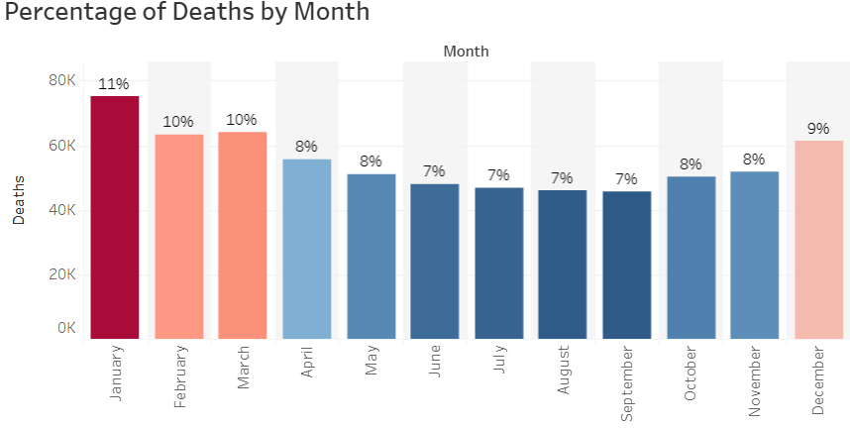
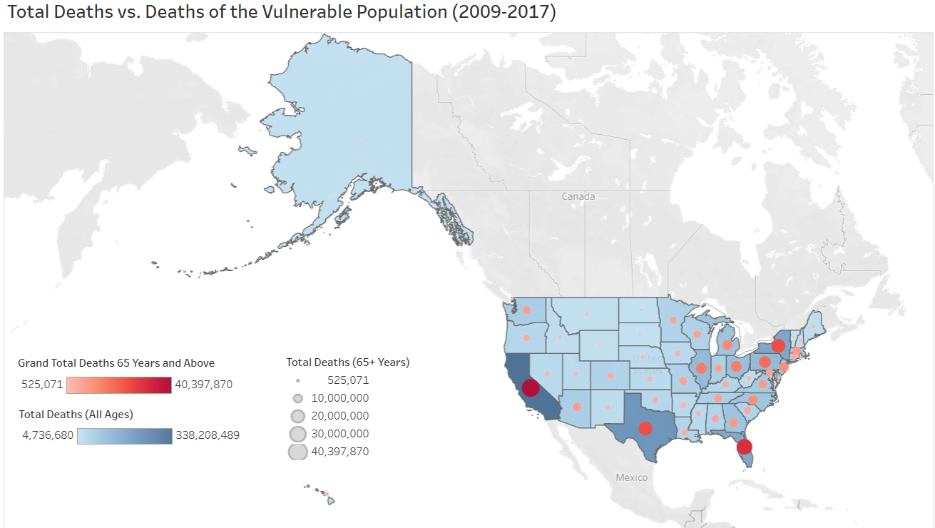
Influenza Deaths by Month and Region
Influenza season peaks from December through March. These are the months where the most staff should be sent to regions that struggle with influenza season.
California, Texas, New York, and Florida have the most influenza related deaths. They have the most deaths in the vulnerable population and total population.

Slide 13
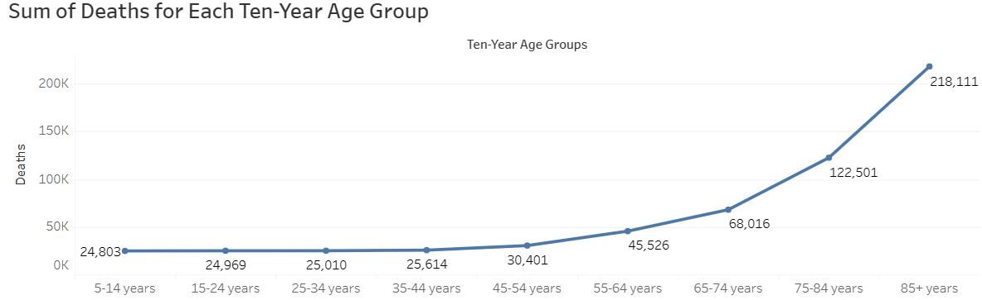
Vulnerable Population
The vulnerable population consists of individuals aged 65 years and older. They account for the most influenza-related deaths.

Slide 14
Analysis Process
For the Influenza Season project, I conducted analysis through Microsoft Excel and Tableau. While using these tools, the goal was to look at variables such as deaths, region, and age (among others).
Using Excel, the data was cleaned and organized. Once this was complete, new columns/groups could be created to separate some of the variables (such as age groups).
Tableau was used to conduct visual analysis and paint a clearer picture of the trends in the data. Conclusions and recommendations from the analysis were made into a storyboard to clearly explain the findings of the study.

Slide 15
Conclusions & Recommendations
In order to determine when and where to send staff, I looked at the death counts by month as well as geographic region. After cleaning the data, Tableau was the main tool I used to visualize the results of my analysis.
The timeframe in which most staff should be sent to assist is December through March, as this is considered the peak of influenza season.
After looking at the death counts due to influenza, the most staff should be sent to California, Texas, New York, and Florida. They are the top four states when looking at deaths caused by influenza

Slide 16
Project Links
Project Brief: Influenza Project Brief
Project Report: Tableau Storyboard
Project Final Presentation: Video Presentation

Slide 17
Rockbuster Stealth Data Analysis Project
Project Goals
Data Sets
Tools Used
Skills Used
Help Rockbuster Stealth LLC launch a new online video rental service.
DVD Rental Dataset
Microsoft Word
Microsoft Excel
Microsoft Powerpoint
Tableau
SQL
DbVisualizer
Excel
Data Cleaning and Summarizing
Database Querying
Data Transformation
Relational Databases
Joining Tables
Subqueries
Storytelling in Tableau
Presenting Results

Slide 18
Rockbuster Project Overview
Rockbuster Stealth LLC is a movie rental company that used to have stores around the world. They have been facing stiff competition from streaming services like Netflix and Amazon Prime. Due to this, the management team is planning to launch its own streaming service in order to stay competitive.
After loading data into a relational database system, I used SQL to analyze the data and answer key questions for the Rockbuster management team.
Key Questions:
Which movies contributed the least/most to revenue gain?
What was the average rental duration for all videos?
Which countries are Rockbuster customers based in?
Where are customers with a high lifetime value based?
Do sales figures vary between geographic regions?

Slide 19
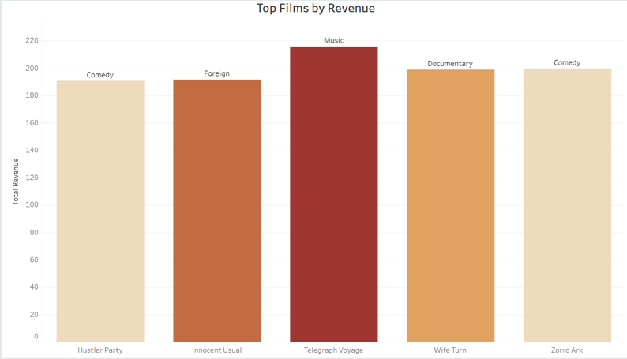
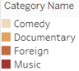
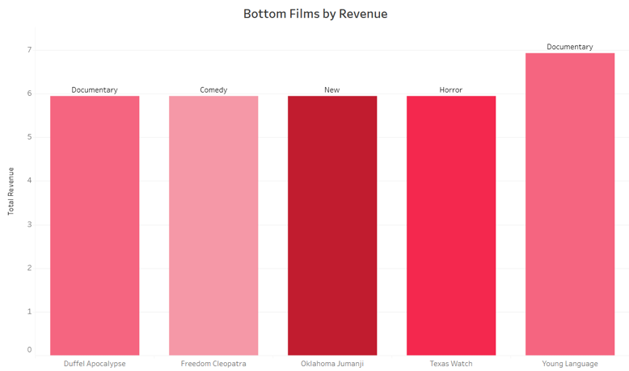
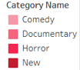
Highest and Lowest Revenue Contribution
The top 5 movies for revenue gain are shown in the top chart. When looking at genres, 2 of the movies were comedy, 1 documentary, 1 foreign, and 1 music.
The bottom movies in terms of revenue gain are shown in the bottom chart. When looking at genres, 2 of the movies were documentary, 1 comedy, 1 new, 1 horror.

Slide 20
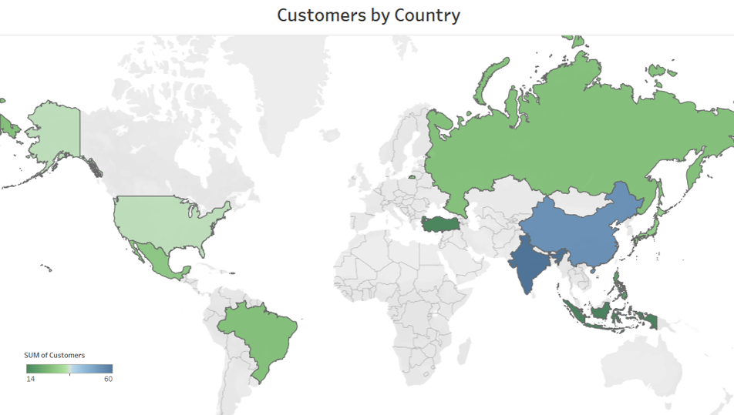
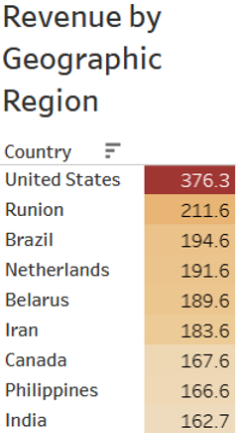
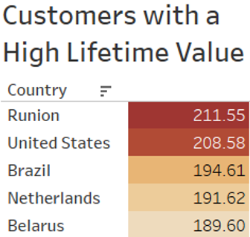
Geographic Regions
India and China had the most customers by a significant amount.
The countries with the most high lifetime value customers were Runion and the United States.
The United States contributed the most to revenue gain out of the other countries.

Slide 21
Analysis Process
For the Rockbuster Stealth project, Microsoft Excel, Tableau, SQL, and DbVisualizer were used to conduct the analysis.
Excel was useful in terms of cleaning minor details in the data. However, SQL was used the most due to the number of tables. It was helpful to use queries and pull data from multiple tables to compare different variables.
By writing many useful queries, I was able to come to conclusions illustrate these through Tableau. Using results from my analysis, as well as visualizations from Tableau, I was able to create a PowerPoint presentation to communicate my findings. I also created a data dictionary in Microsoft Word to clearly show paths between variables as well as information about each variable listed.

Slide 22
Conclusions & Recommendations
I recommend making India, China and the United States a priority since they have the highest customer counts. Advertise in these regions to increase both customer count and revenue gain. For example, Rockbuster could offer promotions to people who refer new customers.
It would be a good idea to investigate the differences in geographic regions to figure out why some countries have more customers than others. Knowing this information could impact Rockbuster’s advertising strategies.
Regions with a small customer count could also have increased advertising to raise awareness of the new streaming service. There is a possibility that people in these areas may simply not be aware of it since it is new.

Slide 23
Project Links
Project Brief: Rockbuster Project Brief
Data Dictionary: Rockbuster Data Dictionary
SQL Codes: Rockbuster SQL Codes
Project Final Presentation: Rockbuster Final Presentation

Slide 24
Instacart Grocery Basket Analysis Project
Project Goals
Data Sets
Tools Used
Skills Used
Uncover more information about Instacart’s sales patterns.
Customers Data Set
“The Instacart Online Grocery Shopping Dataset 2017”, Accessed from www.instacart.com/datasets/grocery-shopping-2017 via Kaggle
Microsoft Word
Microsoft Excel
Microsoft Powerpoint
Python
Jupyter
Pandas
Numpy
Scipy
Seaborn
Matplotlib
Reporting in Excel
Data Cleaning and Wrangling
Data Merging
Deriving Variables
Grouping Data
Aggregating Data
Population Flows
Coding Etiquette
Data Visualization with Python

Slide 25
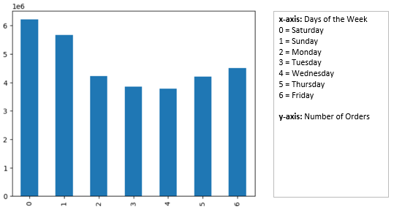
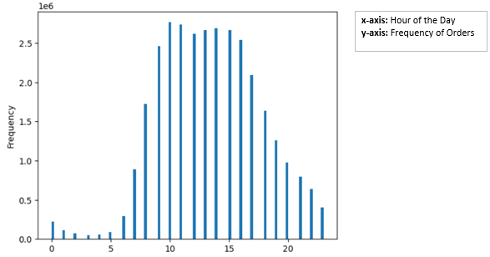
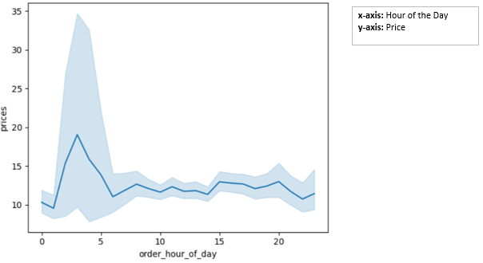
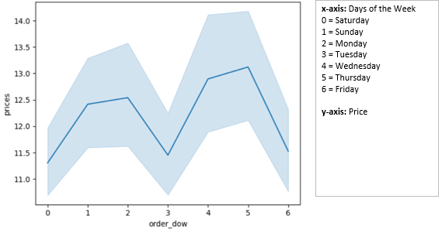
When Do Customers Use Instacart the Most?
The busiest days of the week are Saturday and Sunday, and the busiest hours are between 9am and 5pm. Customers spend the most money on Wednesday and Thursday, and the most expensive items are bought before 5 am.

Slide 26
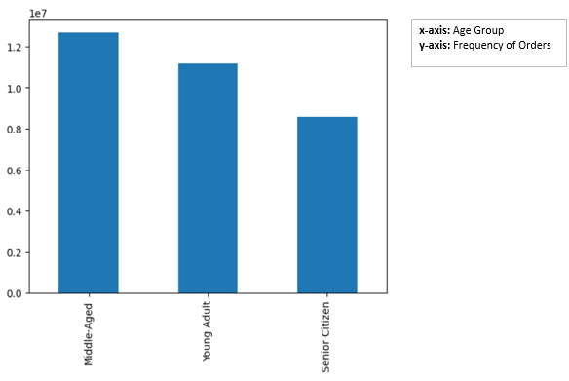
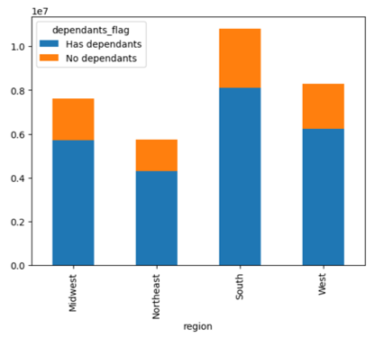
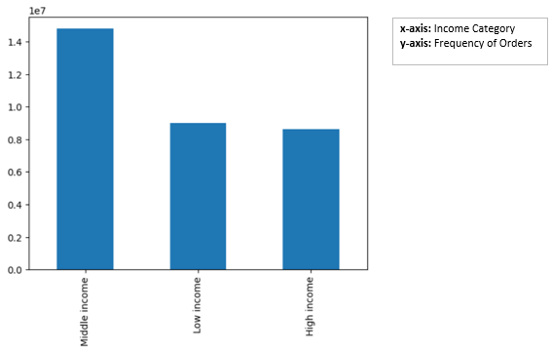
Who Uses Instacart the Most?
Middle-aged people have the highest frequency of orders.
People with dependants were more likely to place orders than those without.
The South had the most Instacart users.
People who fell in the middle-income bracket had highest frequency of orders.

Slide 27
Analysis Process
In order to conduct the Instacart Grocery Basket analysis, I used Microsoft Excel, Python, and Jupyter (as well as the appropriate data libraries).
Excel was used for minor cleanups of the data as well as to create the final report. I used Python and Juptyer to run codes in order to clean and wrangle the data, merge and aggregate the data, and create visualizations.
By using these tools, I was able to conduct a thorough analysis and come to conclusions on things like spending, time of day, day of the week, etc. so that I could make helpful recommendations to Instacart to improve the function of their business.

Slide 28
Conclusions & Recommendations
The busiest days of the week are Saturday and Sunday while the busiest hours of the day are between 9am and 5pm. Customers pend the most money on Wednesday and Thursday and the most expensive items are bought in the morning before 5am.
The departments with the highest frequency of orders were the egg/dairy departments. Someone who is middle-aged, has dependents, have a middle income, and lives in the South would be the most likely to use Instacart.
Instacart could promote special deals on other days of the week besides Saturday and Sunday to increase orders. Now that they know their key demographic, they can advertise more affectively and should focus on the people with these characteristics.

Slide 29
Project Links
Project Brief: Instacart Project Brief
Project Report: Instacart Final Report
Github: Github Profile

Slide 30
Anti-Money Laundering Projects at Global Bank
Project Goals
Data Sets
Tools Used
Skills Used
Provide analytical support to Pig E. Bank’s anti-money-laundering compliance department.
Pig E. Bank Data
Microsoft Word
Microsoft Excel
Microsoft Powerpoint
Github
Excel
Big Data
Data Ethics
Data Mining
Predictive Analysis
Time Series Analysis and Forecasting
Github

Slide 31
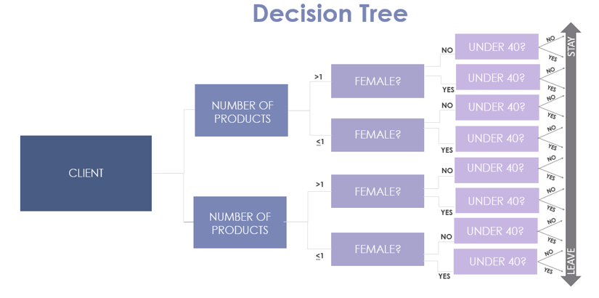
Client Loss
Females are more likely to leave the bank than males by a difference of 18%.
The average age of clients who left the bank is 37.
Clients with less products were more likely to exit the bank.

Slide 32
Analysis Process
The Anti-Money Laundering Project required the use of Microsoft Excel, PowerPoint, and Github.
The main tool for this analysis that I used was creating a decision tree. This was used to show who was most and least likely to leave the bank.
Github was used to display findings.

Slide 33
Conclusions & Recommendations
Females are more likely to leave the bank than males. Clients who were under the age of 40 were more likely to leave the bank than those who were not. The less products a person had, the more likely they were to leave the bank.
Pig E. Bank should investigate why clients with these characteristics are most likely to leave the bank.

Slide 34
Project Links
Project Brief: Pig E. Bank Project Brief
Project Report: Pig E. Bank Final Report

Slide 35
World Happiness Report Analysis
Project Goals
Data Sets
Tools Used
Skills Used
Discover more about the trends of world happiness to make recommendations about future policies.
World Happiness Data
Federal Reserve Economic Data
Microsoft Word
Microsoft Excel
Python
Jupyter
Microsoft Powerpoint
Github
Tableau
Exploratory Data Analysis
Geospatial Analysis
Data Ethics
Data Mining
Machine Learning
Time Series Analysis
Sourcing Data
Regression Analysis
Cluster Analysis

Slide 36
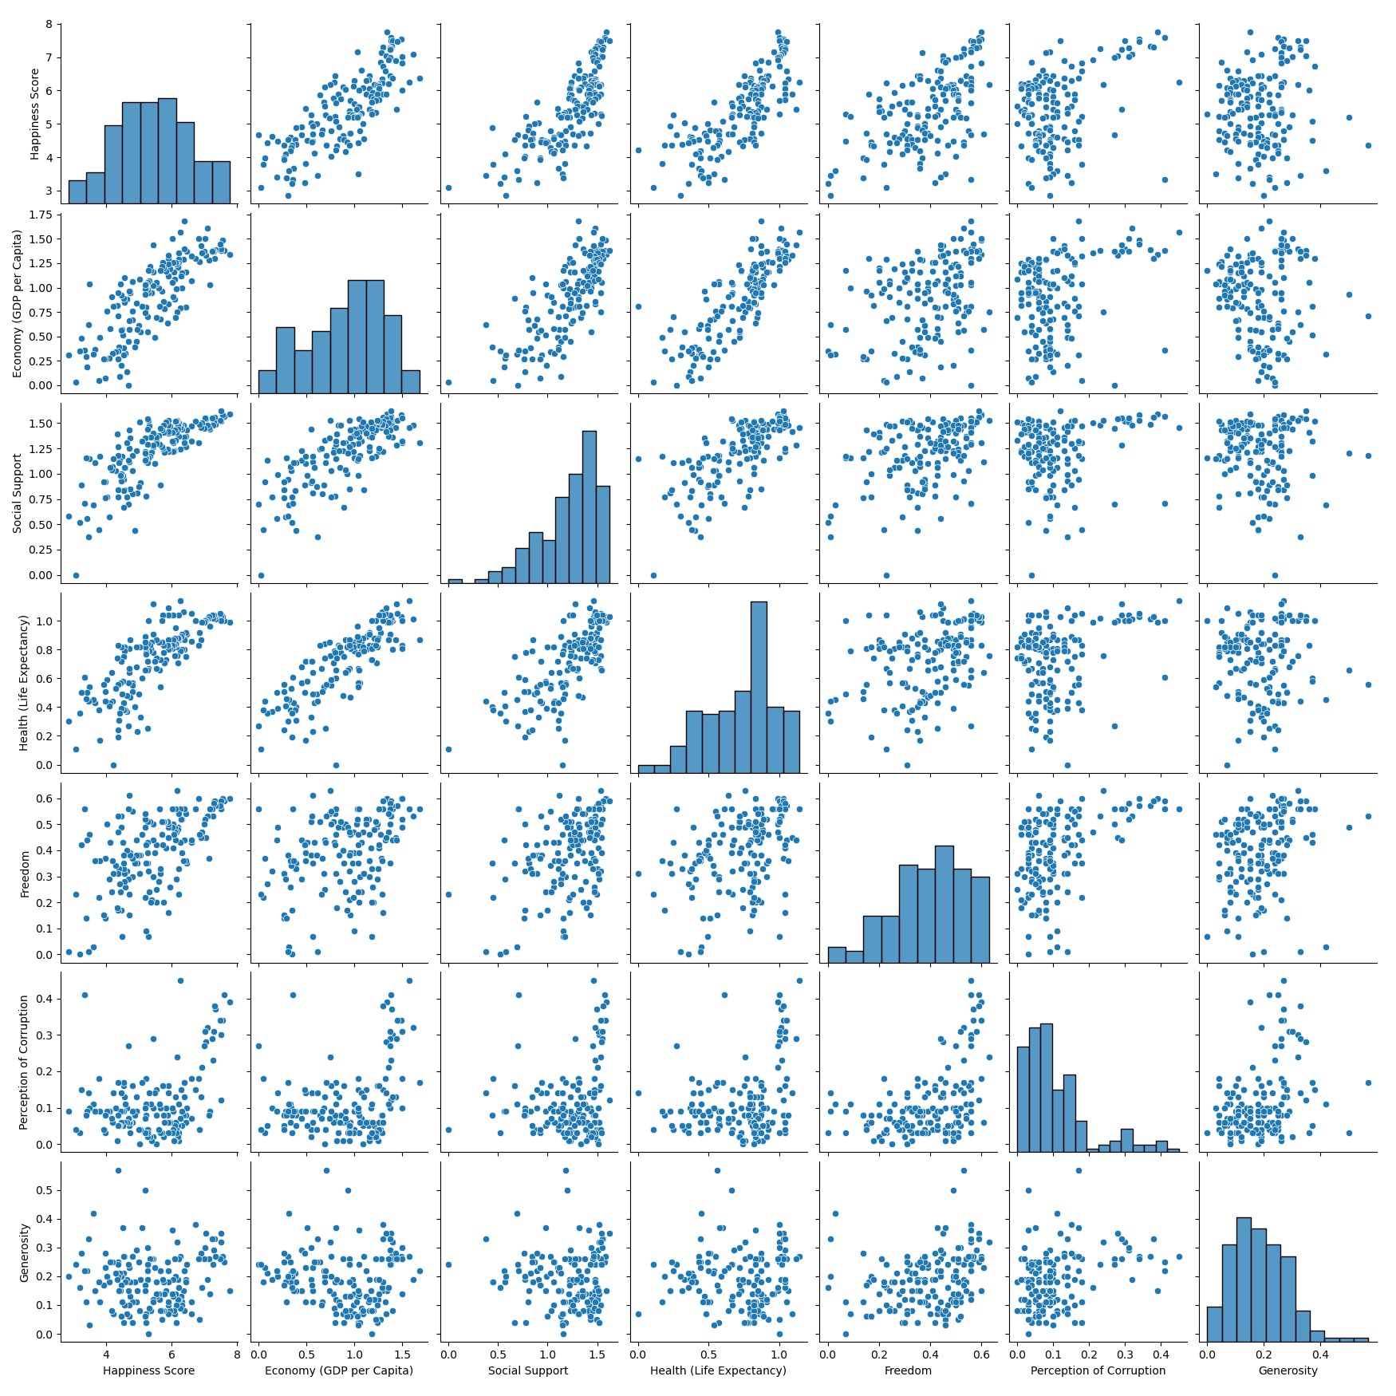
Correlations Between Happiness Score and Variables
Economy (GDP per Capita), Social Support, and Health (Life Expectancy) had strong, positive correlations with the Happiness Score. This means that as scores for the three variables increased, so did the Happiness Score.
The focus for the analysis was on Economy, Social Support, and Health. This was this case because Freedom, Trust (Perception of Corruption), and Generosity didn’t have a strong correlation or impact on the Happiness Score.

Slide 37
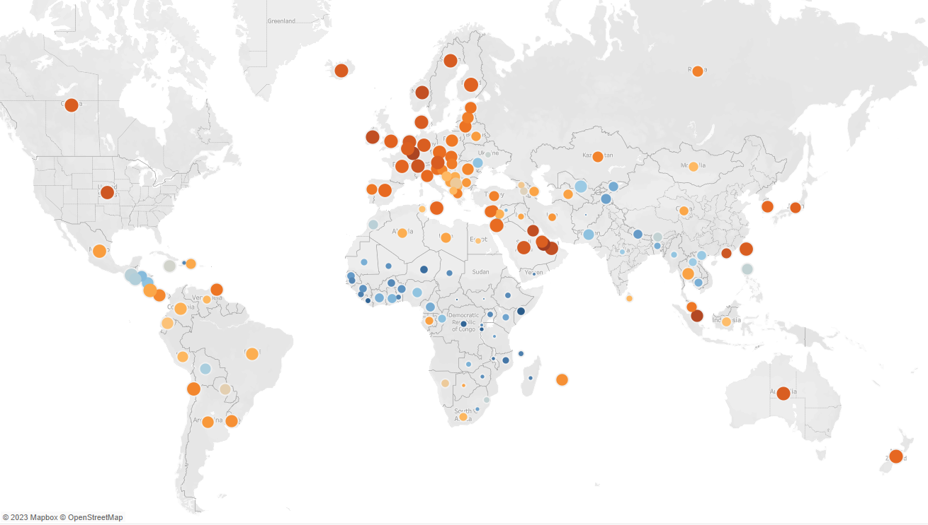
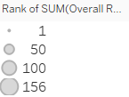
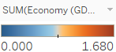
Happiness Rank and Variables
The map to the right demonstrates how if a country has a good economic score, then they are likely to have a high overall rank when compared to other countries.
This is true for the Social Support and Health (Life Expectancy) variables as well.

Slide 38
Analysis Process
The World Happiness Report project required the use of Microsoft Excel, Python, Jupyter, Tableau, and Github.
Excel was used to fix minor issues with the data while Python and Jupyter were used to handle any larger issues.
Tableau was used in order to visualize the results of the analysis so the audience could clearly see trends and patterns in the data.
Github was used to display the final project.

Slide 39
Conclusions & Recommendations
A country with a good economy, strong social support, and good health/long life expectancy are much more likely to have a high Happiness Score and therefore a high overall rank when compared to other countries who do not.
If a country wants to increase the happiness of their people, they should focus on implementing policies surrounding growing the economy, social support, and health.

Slide 40
Project Links
Project Brief: World Happiness Report Project Brief
Project Report: Tableau Storyboard
Github:

Slide 41

Thank you!
Contact information:
Email: ava.m.kramer@gmail.com
LinkedIn: Ava Kramer Profile

